Slide 1


Team Details
  Team name: finwing
  Team leader name: Hrutik Kumthekar
  Problem Statement: Media, Content & Digital Experiences — turning static learning content into playable, verified game worlds

Slide 2
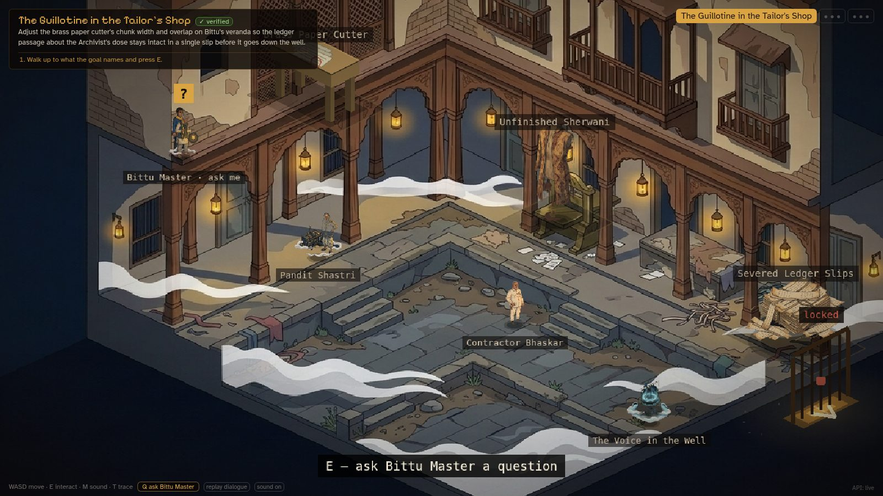



BRIEF ABOUT THE IDEA
Upload any chapter. Play it. Win only by using the concept
Upload your chapter
Notes, a textbook chapter or a PDF. Gemini pulls out the concepts, the rules and the usual misconceptions.
Gemini builds a world
A story RPG with a villain, a twist and one concept per act. Nano Banana paints it.
Win by using the idea
Drive, aim, order a process, pin evidence, tune a RAG pipeline. No multiple choice.
Seven Sharp at the Haveli: built by Gemini from a RAG textbook chapter, played with live retrieval over that same chapter.
Gemini writes it, Nano Banana paints it — and the game’s own code proves every level winnable, unguessable and grounded in your notes before you play.

Slide 3



OPPORTUNITIES
Others skin a quiz. We make the concept the controller
 | Prompt-to-game tools | Notes-to-quiz apps | Quiz RPG makers | Chapter Quest
Reads your own material | ✗ | ✓ | ~ | ✓
You win by using the concept, not answering MCQs | ~ | ✗ | ✗ | ✓
Every level proved winnable and grounded in your notes | ✗ | ✗ | ✗ | ✓
Adapts to the misconception you just showed | ✗ | ~ | ✗ | ✓
How it solves the problem
Reading is passive. Here you predict, act, and see why — and a character who embodies your exact mistake walks in to argue it.
USP: verified before you play
Every act is proved winnable; guessing wins ≤6%; every rule is quoted word for word from your notes; Gemini play-tests its own levels.
The opportunity
Every learner already has the content. We turn it into an interactive digital experience in about two minutes.
✓ yes ~ partly ✗ no — categories as we assessed them, not an endorsement by any vendor

Slide 4







LIST OF FEATURES OFFERED BY THE SOLUTION
Four ways to play, every level verified before you play
Formula worlds
Drive a train, aim a launch, balance a beam. A real simulator decides, never the AI.
Sequence boards
Order a process or a causal chain. A broken link explains why, quoted from your notes.
Evidence boards
Pin each document to the claim it proves. Decoys explain what they really show.
Live RAG worlds
Tune chunking, top-k and grounding over your own chapter, with Gemini embeddings.
The ✓ verified card
See what was proved: start loses, a win exists, guess odds, every citation.
Misconception characters
Miss, and the character who embodies your wrong idea walks in. Reply in ~1.5 s.
Predict, then compare
Commit to a guess first; after the win, see it against reality — and where the analogy breaks.
Painted worlds
Nano Banana paints the cast, props and rooms in one consistent style.

Slide 5







PROCESS FLOW DIAGRAM OR USE-CASE DIAGRAM
Chapter to verified game in ~2 minutes, then it adapts to you
BUILD once per chapter, ~2 min, cached forever
Your chapter
notes, textbook, PDF
Curriculum agent
concepts and misconceptions
Writers’ room
2 film-genre drafts, a judge picks
Act writers
levels as structured JSON
Verify gate
simulator · citations · evidence judge · live RAG run
Nano Banana
cast, props and rooms painted
Fails? Gemini play-tests and fixes it with tools
PLAY every attempt
Every verdict comes from the game’s code; Gemini explains, never judges a win.
Win → insight card (your guess vs reality, where the analogy breaks) → gate opens
Predict
commit to a guess
Act in the world
dials, boards, satchel
Code decides
deterministic verdict, no AI opinion
Miss → Gemini names your misconception; its character walks in; try again ↺

Slide 6
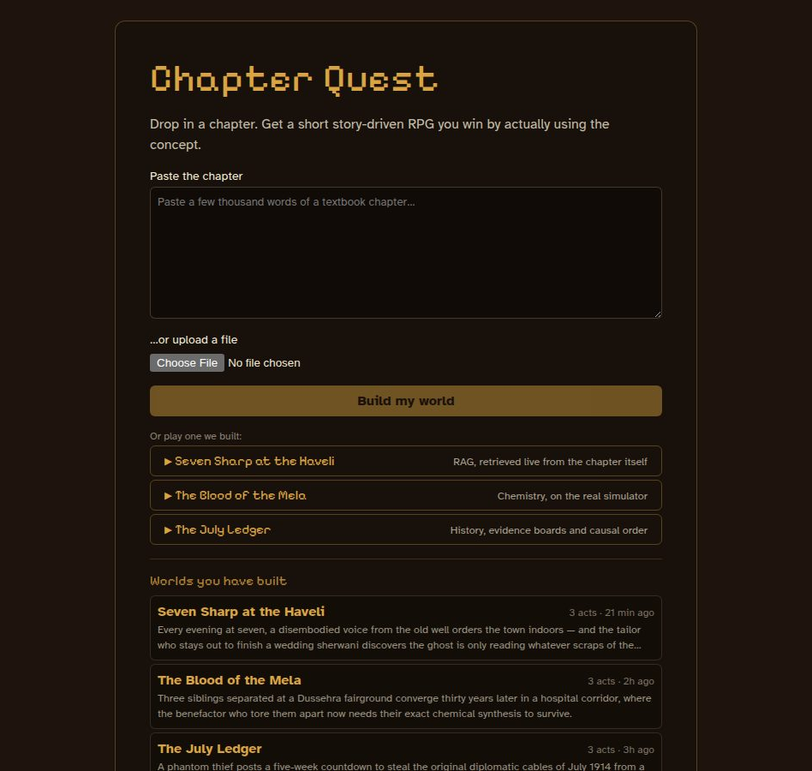
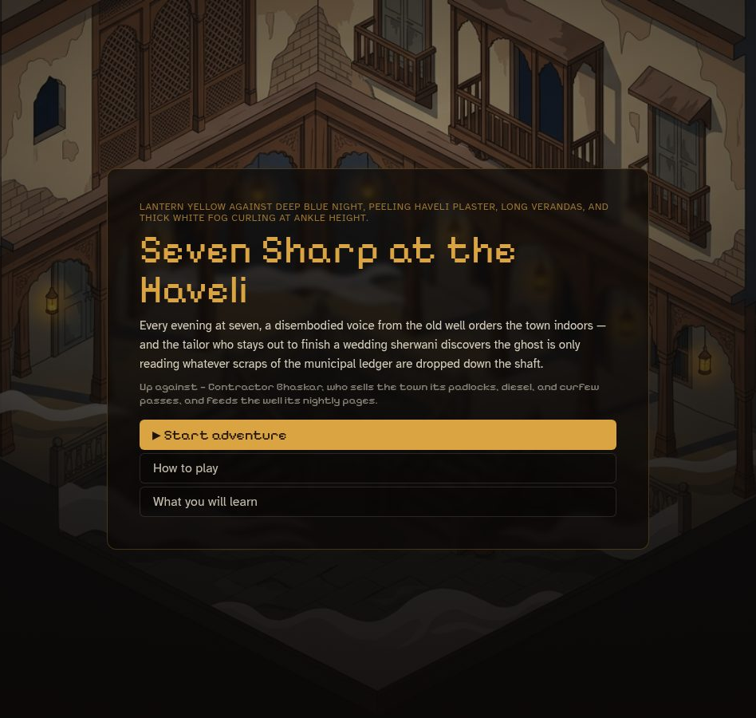
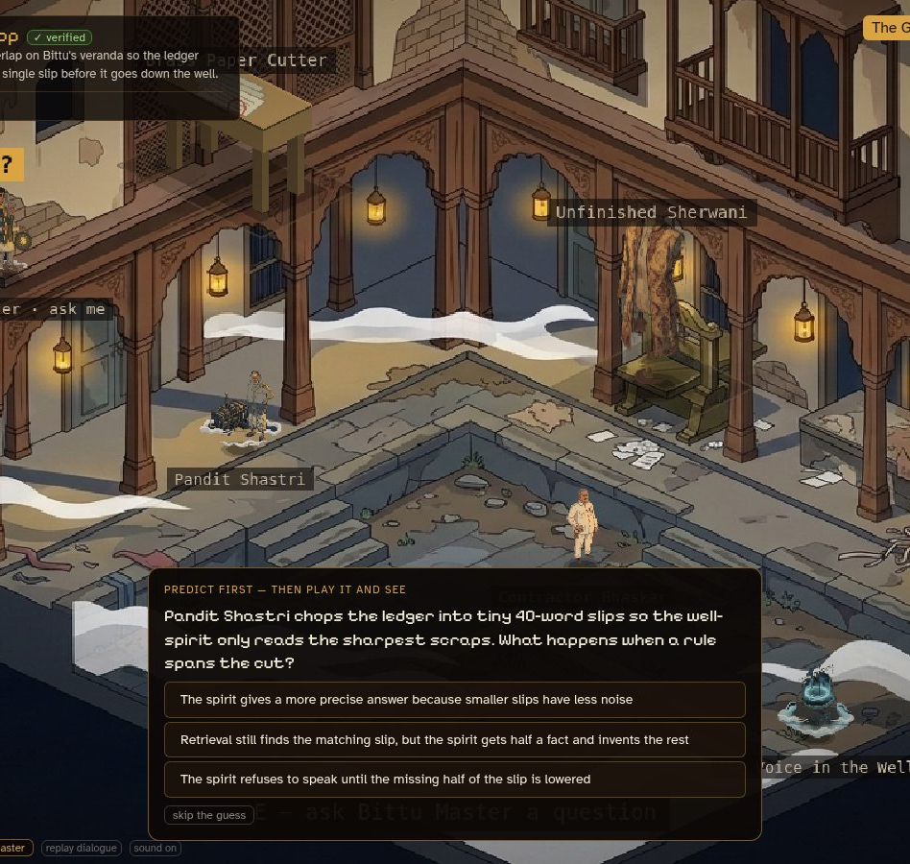
WIREFRAMES/MOCK DIAGRAMS OF THE PROPOSED SOLUTION
Not mock-ups: real screens from the running prototype
1. Paste or pick
Drop in a chapter, or open a world we built: RAG, chemistry, history.
2. A world, not a worksheet
Every chapter gets a title, a cast, a villain and a painted style.
3. Predict first
A guess before the act, compared with reality after it.

Slide 7

ARCHITECTURE DIAGRAM OF THE PROPOSED SOLUTION
One Cloud Run service, Gemini at every stage, code as referee
Browser
Cloud Run — one container
Gemini API
React 18 UI: boards, ✓ verified card, adaptation cards
Phaser 3 isometric engine: painted rooms, cast, gates
Typed API client; live build progress over SSE
Mock mode: the demo runs with no server at all
Design pipeline curriculum → writers’ room → act writers
Gemini 4 Argon
design, act writing, evidence judge
Gemini 3.8 Flash
play-tester, Oracle answers, RAG judge
Gemini 3.5 Flash-Lite
guide, adaptation, reranking
Nano Banana 2.1
the art
Gemini Embedding
retrieval over the chapter
Verifier simulator, citations, guess odds — deterministic
Play-tester agent Gemini function calling over the game
Live RAG chunk · embed · retrieve · rerank · answer · judge
Guide & adaptation misconception diagnosis, ~1.5 s
Caches scripts, art, RAG runs — keyed by chapter hash
Deploy: Docker → Cloud Build / Artifact Registry → Cloud Run · API key in Secret Manager · built worlds and art ship inside the image, so the demo opens instantly

Slide 8
TECHNOLOGIES TO BE USED IN THE SOLUTION
Gemini, used five ways — on Google Cloud, end to end
Model | What it does here | Gemini capability
Gemini 4 Argon | Curriculum, story drafts and judge, act writing, evidence judge | Structured output (JSON schemas), PDF input
Gemini 3.8 Flash | Play-tester agent, Oracle answers, RAG judge | Function calling (tool use)
Gemini 3.5 Flash-Lite | Guide, misconception diagnosis, reranking | Low-latency structured output
Nano Banana 2.1 | Cast, props, rooms, walk sheets | Image generation with a style reference
Gemini Embedding | Live retrieval over the uploaded chapter | Embeddings
Cloud & app stack
Cloud Run
Cloud Build
Artifact Registry
Secret Manager
TypeScript monorepo
React 18 + Vite
Phaser 3
Node 20 + Express
Docker
node:test — 231 tests
Playwright headless QA
pdf.js
Everything the AI makes is structured data. Nothing it writes is executed — the game’s own code runs every check.

Slide 9
ESTIMATED IMPLEMENTATION COST (OPTIONAL)
Pay once per chapter. Every replay is free
 | What it takes | Basis
Build a world (script) | ≈13 model calls, ≈95k tokens | Measured: average of 8 chapters
Paint a world | 16–21 Nano Banana images | Measured; 3 painted at once, ~2 min
Replay a built world | $0 — scripts, art and RAG runs cached | Measured: cache keyed by chapter hash
One adaptation (per miss) | 1 Flash-Lite call, ~1.5 s | Measured latency
Hosting | One Cloud Run container, scales to zero | 745 MB image
≈$0.20–0.40
to write and verify one world’s script*
$0
to replay it, for any number of learners
~1.5 s
for a misconception-aware hint
*Estimate at the per-token prices our router reports for Gemini 4 Argon ($2 in / $10 out per 1M tokens); the range covers the unmeasured input/output split. Image pricing excluded.

Slide 10
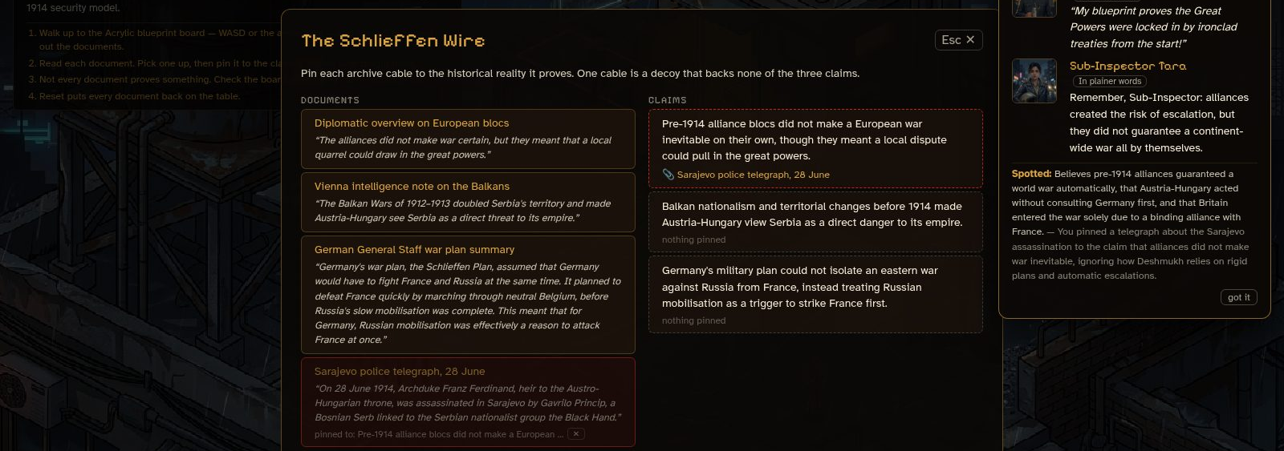
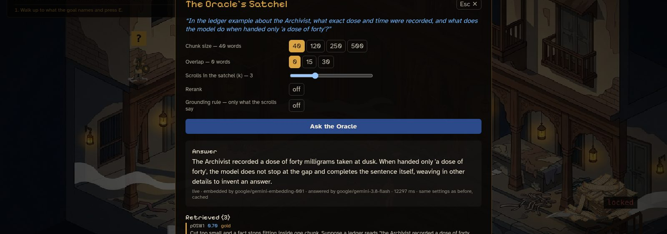
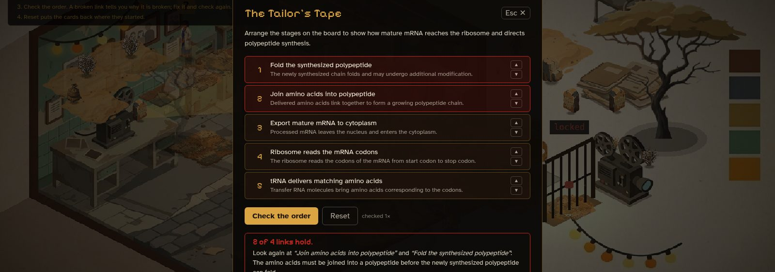
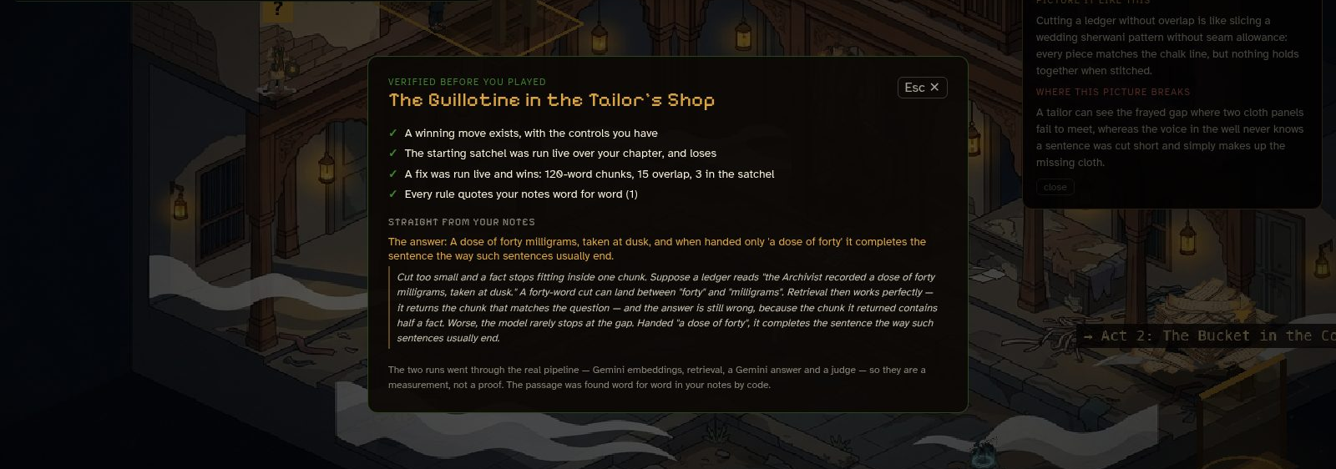
SNAPSHOTS OF THE PROTOTYPE
Snapshots from the working prototype
Pin the wrong document — the character who embodies your mistake walks in
Live RAG over the chapter: a right answer still fails — the fact was torn
Order a process; a broken link explains itself, quoted from your notes
The ✓ verified card: what was proved before you played

Slide 11
PROTOTYPE PERFORMANCE REPORT/BENCHMARKING
Measured, not claimed: 8 real chapters rebuilt from scratch
8/8
22/22
≤6%
chapters became a game from their own content
acts proved finishable
worst-case odds of winning by guessing
74
3/3
2.5×
citations checked word for word against notes
RAG acts run live: start loses, a fix wins
faster art: 319 s → 128 s for 16 images
Our bar for every act: random play must almost always lose. Build: ~2 min per world, 13 calls. Eval run 18 Oct 2026 with live Gemini; the evidence judge is a model and is labelled as one.

Slide 12







ADDITIONAL DETAILS/FUTURE DEVELOPMENT (IF ANY)
Next: every kind of concept, every classroom, every language
NEXT 4 WEEKS
NEXT QUARTER
VISION
Definitions & arguments
a mechanic for the last 8% of concepts we refuse today
Teacher dashboard
class-wide misconception maps from real attempts
Voice characters
argue with the misconception, out loud (Gemini Live)
Gemini vision art QA
every painted asset checked against what it should show
Indian languages
worlds written and voiced in the learner’s language
Publisher toolkit
any content library → verified interactive worlds
Context caching
the chapter cached once per build: faster, cheaper
Classroom & LMS
assign a chapter, track who has played it
Open verifier
the checks as a standard for generated learning games

Slide 13

Provide links to your:
GitHub Public Repository: https://github.com/capsemble/akagami
Demo Video Link (3 Minutes): https://youtu.be/hQ37h01j54o?si=LffNu72vj9co_8sH
Final Product Link: https://chapter-quest-140843079737.asia-southeast1.run.app
Try it in 60 seconds
1
Open the product link and pick “Seven Sharp at the Haveli” — a RAG chapter turned into a game.
2
Ask the Oracle with the torn 40-word chunks: the answer is right, the act still fails. Fix the chunking — it passes.
3
Open “The July Ledger”, pin the wrong document, and watch the misconception’s own character walk in.
4
Or paste your own notes and watch the build verify every level live.

Slide 14


